Slide 1

Shared Preferences API
Discipline of IT
James Cook University

Slide 2
SharedPreferences is a class that provides a way of easily saving and loading configuration data or UI state
When an Activity is destroyed, the state of its UI elements is lost
But you can use SharedPreferences to save the state and reload it when the Activity restarts
The user is unaware of the reload!
It also offers a way to save configuration data for an app
It uses key-value pairs to store primitive data

Slide 3
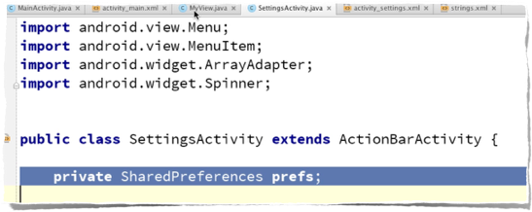
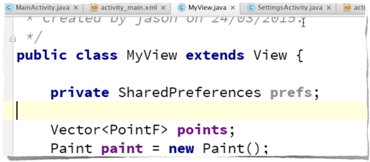
How to use SharedPreferences
Add a variable in the classes you need to give access to the preferences data from

Slide 4
How to use SharedPreferences
Then use Activity.getSharedPreferences()
The string argument is the unique name for a specific shared preferences data source
The mode can be public to all apps, or private to the app

Slide 5
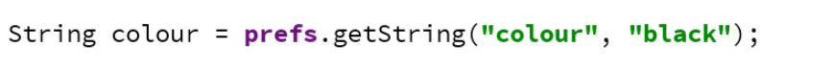
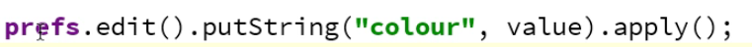
How to use SharedPreferences
Once you have the preferences object, you can use it to add or read data via key-value pairs:
Look at the SharedPreferences API for details

Slide 6
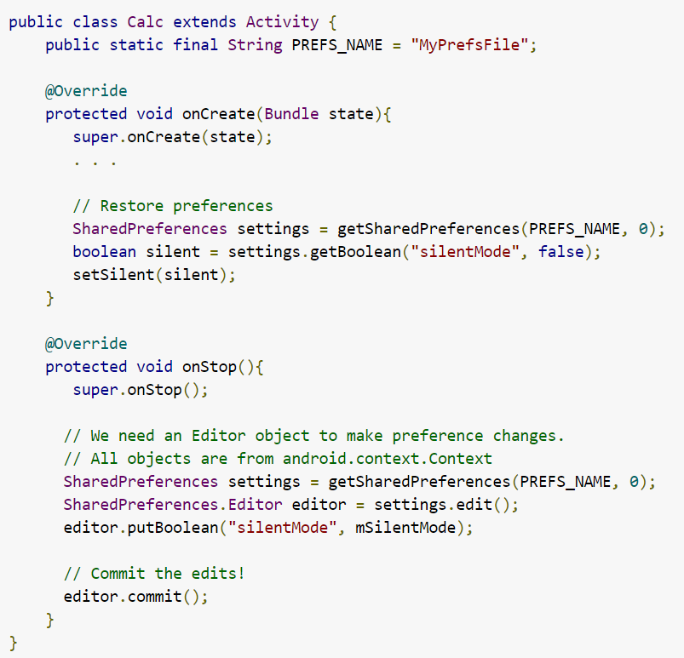
Another example

Slide 7
Summary
Shared preferences is a useful but simple data storage mechanism for your apps

